Slide 1
Daniel Tilley C14337041 DT228 - 4
Training Pal
Final Presentation
30th April

Slide 2
Introduction
Quick Refresher about Training Pal
Structure of Presentation

Slide 3
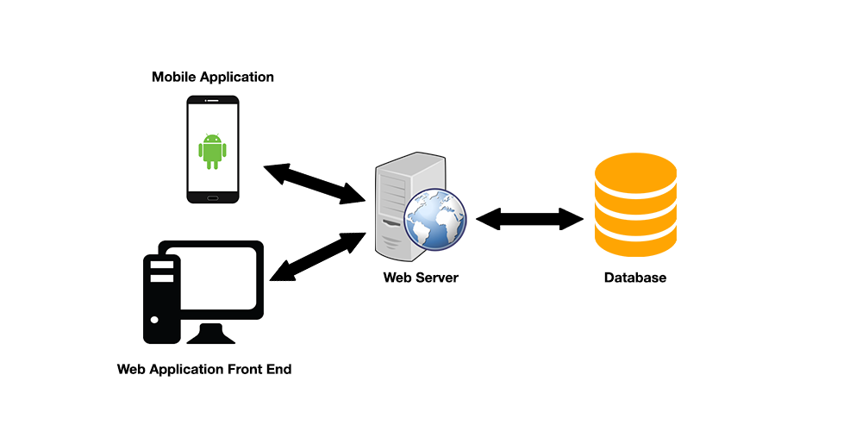
Brief Overview

Slide 4
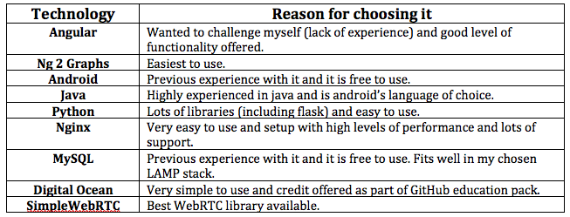
Chosen Technologies

Slide 5
Key Features
Athlete / Coach User Profiles
Training Logs
Training Targets
Templates
Data Management
Events
Data Visualization

Slide 6
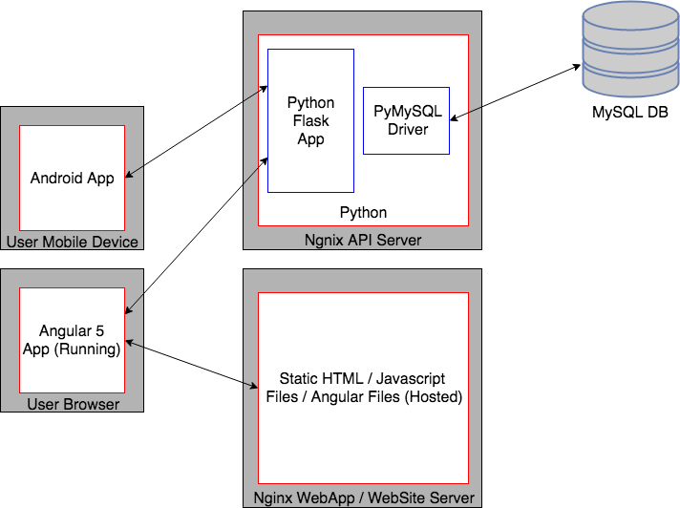
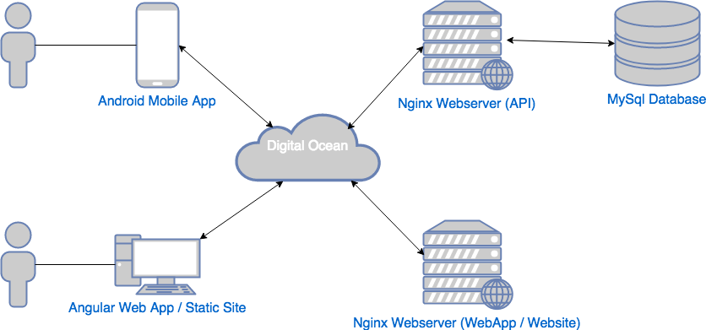
Technical Architecture

Slide 7
Development + Implementation
Different Phases
Angular App
Mobile App
Backend API

Slide 8
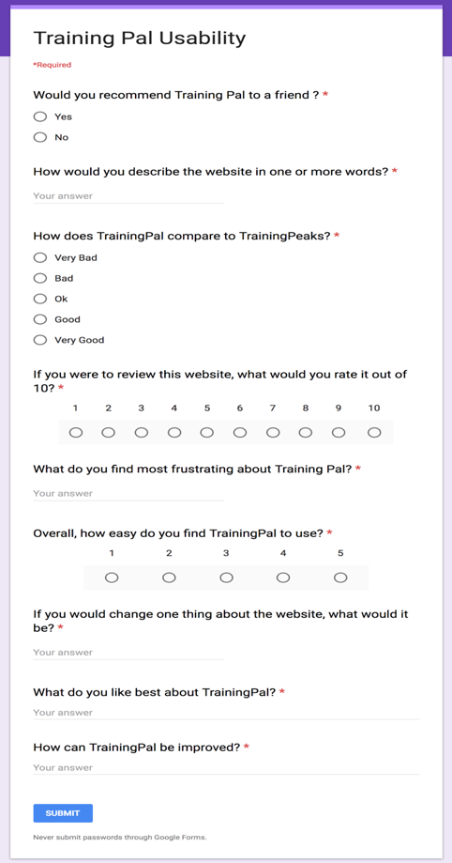
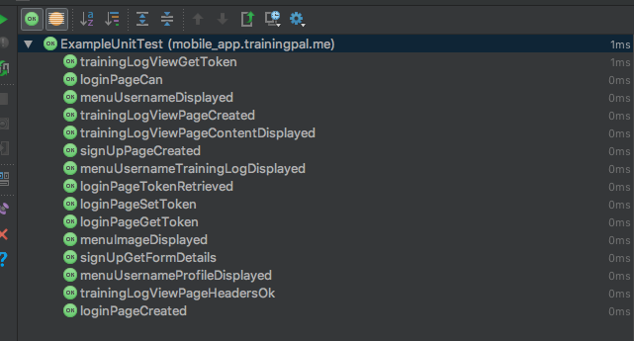
System Validation

Slide 9
Evaluation
Planned vs Actual Estimates
Changes Made
System Testing and The Results
What Would I Change If I Was to Redo It?
Success? Failure?

Slide 10
Future Work

Slide 11
Demo

Slide 12
Conclusion
Any Questions???

